Slide 1
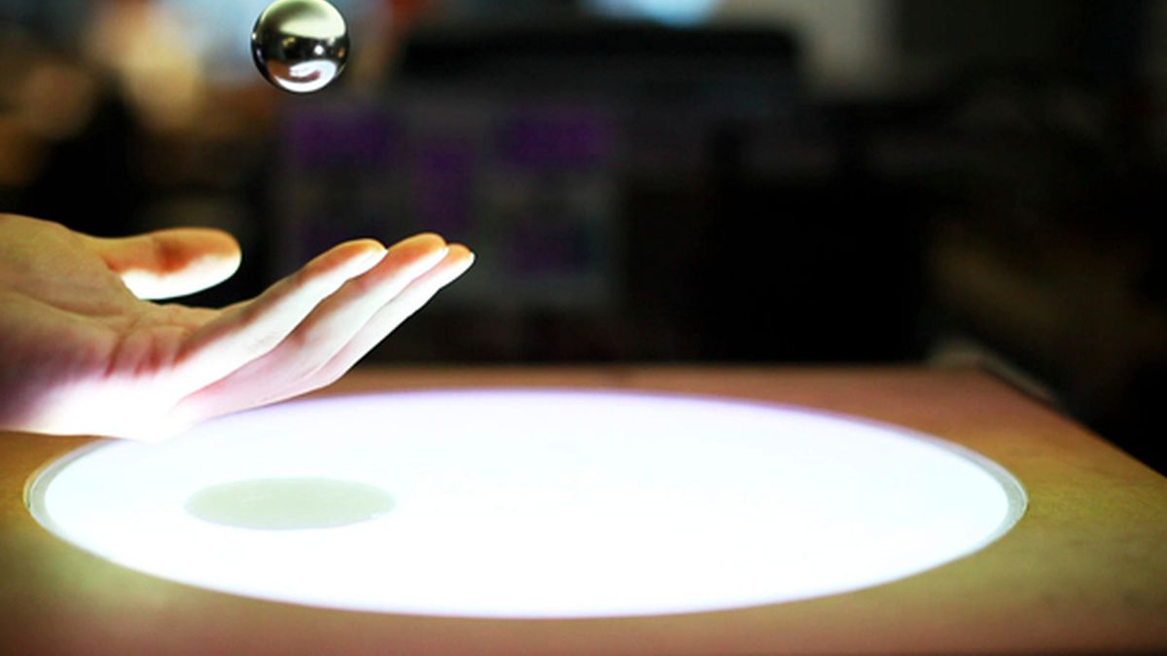
Magnetic Levitation
Team 19 (eyeotea)
Nikhil Agrawal (2020102021)
Deepthi Chandak (2020102013)
Tarun Jindal (2020102056)
Mitul Garg (2020102026)
Atharv Sujlegaonkar (2020102025)

Slide 2

Contents
1. Objective and the principle behind the experiment
2. Hardware setup
3. physics
4. Flowchart of IoT based setup
5. circuit setup
6.Flow chart of the code
7. Link of demo

Slide 3
Objective
Calculation of height of electromagnet coil from varying current and estimation of force on coil.
Principle
An electric field is generated by a current-carrying coil, and the force due to the magnetic field increases on increasing the current applied to the coil. An increase in force is indicated in this experiment by the height attained by the coil when subjected to the magnetic field of the other permanent magnets in the setup of the experiment.

Slide 4
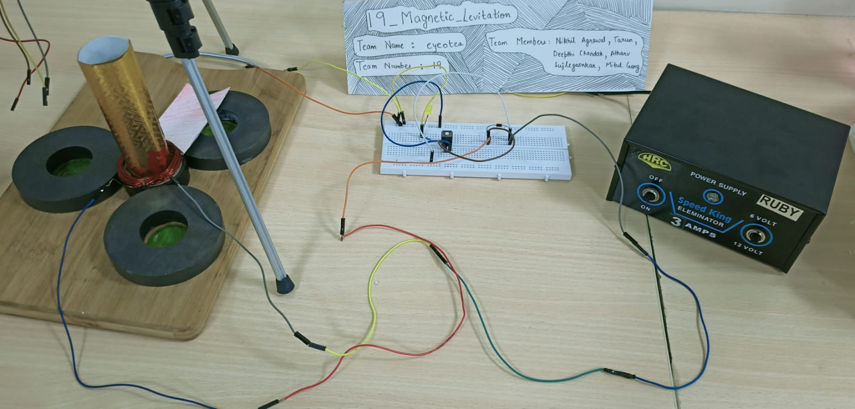

Slide 5
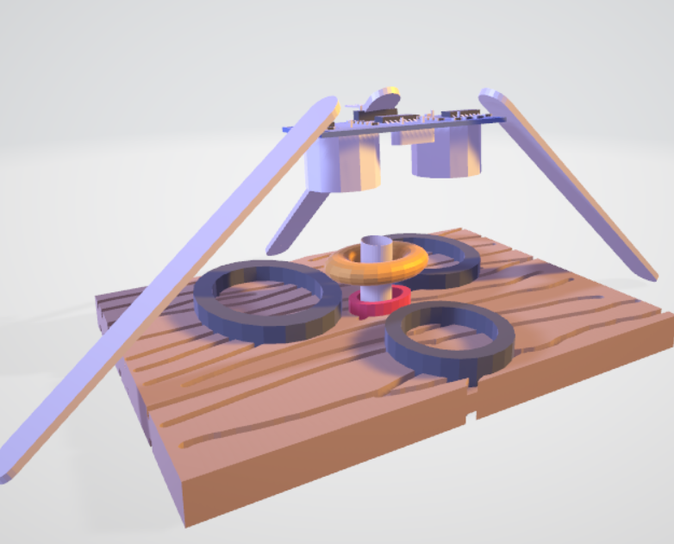
Hardware Setup
This is hardware representation without iot .
Here on varying current in coil the flux through coil changes and the electromagnet repels permanent magnet and thus due to the force of repulsion the coil levitates .
On varying current the height of coil that it levitates changes .

Slide 6
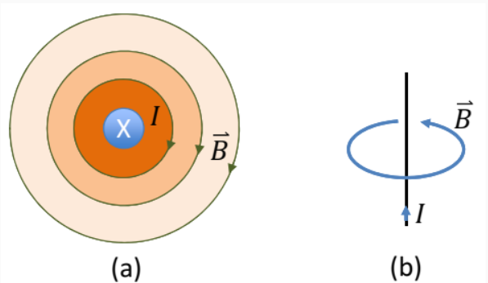
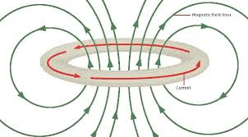
Physics
Ampere’s Law: A current through any conductor creates a circular magnetic field around the conductor.
The advantage of using the coil shape is that it increases the strength of the magnetic field produced by a given current. The magnetic fields generated by the separate turns of wire all pass through the center of the coil and add (superpose) to produce a strong field there. The more turns of wire, the stronger the field produced.

Slide 7
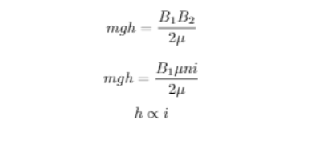
Physics
The magnetic field produced by the coil is in the opposite direction to the net magnetic field produced by the magnets.
We can find relation between height attained by the coil from the magnets and current by applying the theorem of conservation of energy.
Here in this equation B1(magnetic field of permanent magnet) is constant and B2 varies linearly with current.

Slide 8
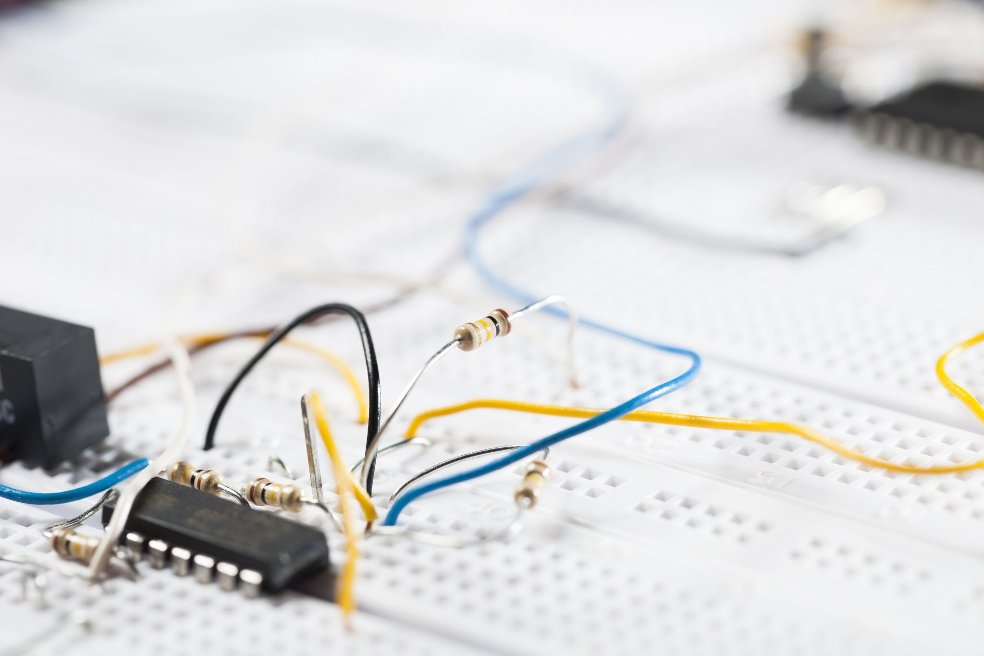
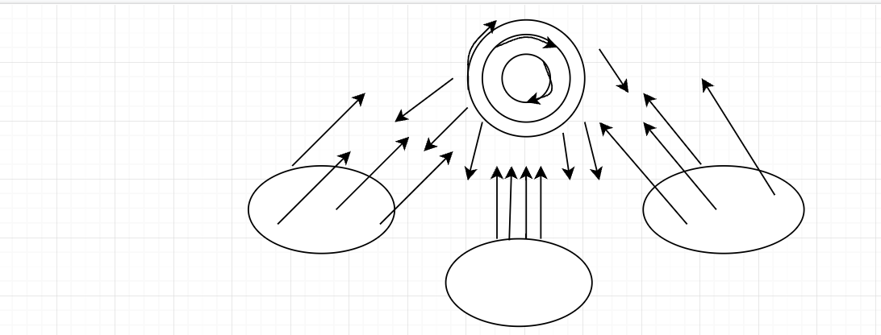
Physics
Current through the coil = I amperes
Height attained by the coil = (distance of the ultrasonic sensor from the ground) – (distance measured by the sensor when coil levitates) = h cm
FBD of coil when it levitates:

Slide 9
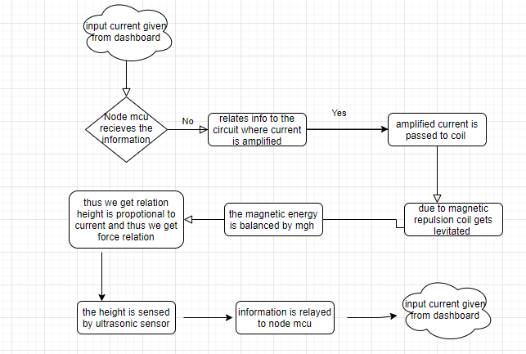

Slide 10

IoT-based setup
Dashboard
Measures levitation height
Ultrasonic
Distance
Sensor
NODE
MCU
Distance of coil in levitation from the sensor
Output height
Current
Input
Coil levitates to balance the electromagnetic & gravitational forces
Hardware
Setup
Circuit Setup
Voltage variance & current amplification
Amplified current is passed to the coil

Slide 11
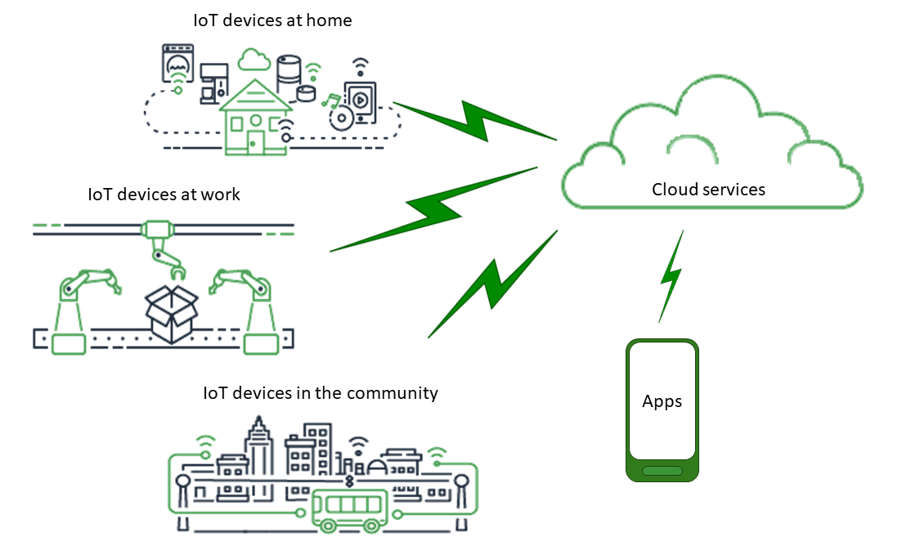
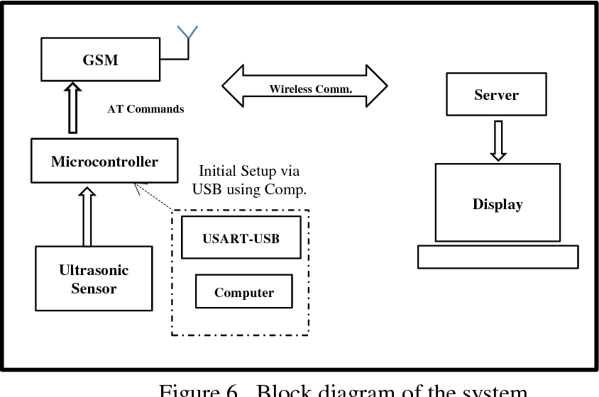

Slide 12
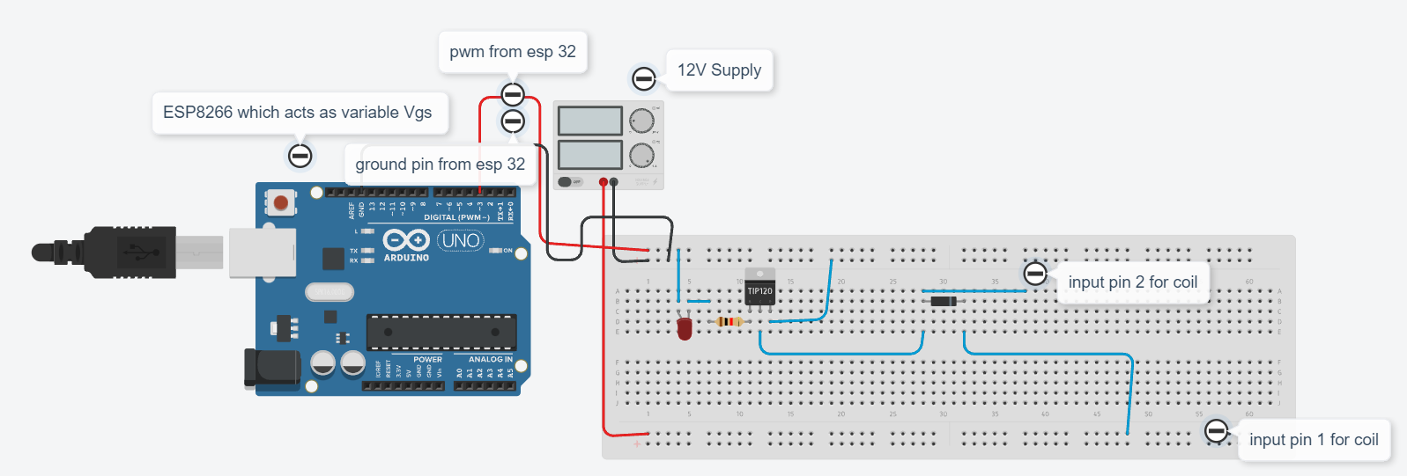
Circuit Setup

Slide 13
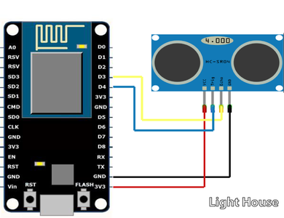
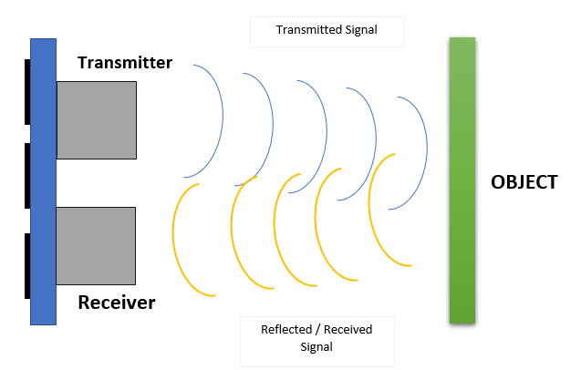
Ultrasonic sensor

Slide 14
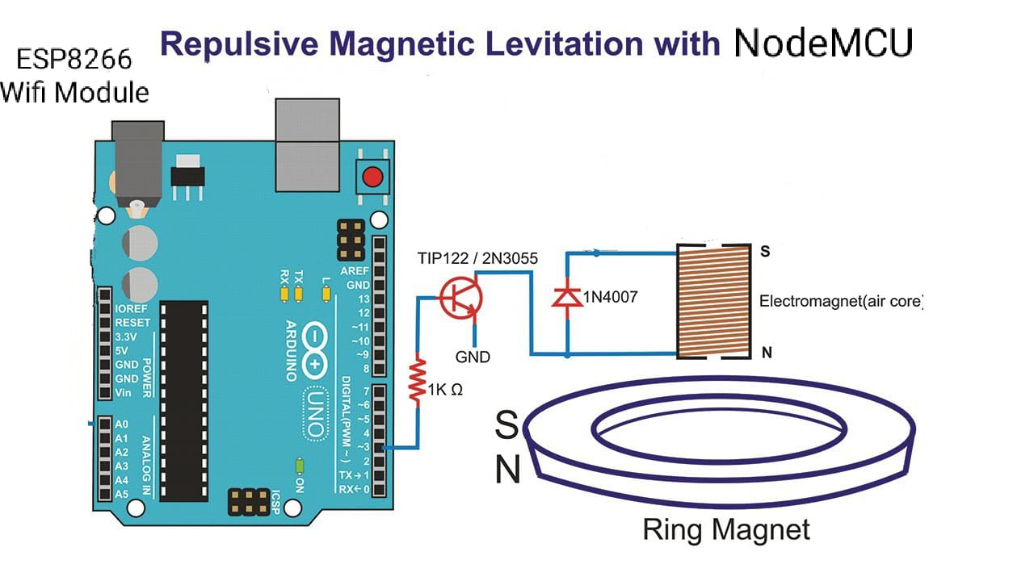

Slide 15

Dashboard
Dashboard is the most important part of any Iot project.we control our hardware setup by seating anywhere in the world through the dashboard.
We have made the dashboard using blynk app/software.
We have many tools in our dashboard :
1.Slider : This slider is used to vary the input voltage coming from nodemcu.
2.Lcd screen : The lcd screen basically displays text or value.
3. distance bar : We use this tool to display the distance of coil from the permanent magnet using the ultrasonic sensor
4 .Video streaming : This is the most crucial part of dashboard where we stream the working of hardware setup using the esp32 camera module

Slide 16
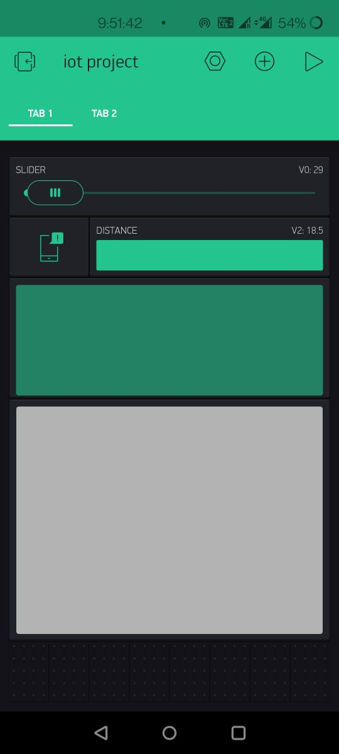
Dashboard View

Slide 17
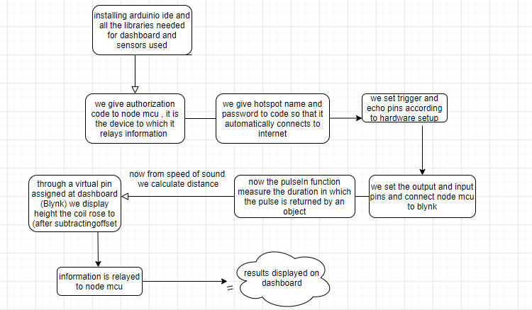
Flow of code

Slide 18
Demo
click here for video

